Slide 1

Modeling VIII

Slide 2
Introduction
Big Data
Large Sample Size
Large Number of Variables
Traditional Methods are Difficult to Implement
Depends on the Available Technology
Goal: Explore Approaches for Quick Filtering of Predictors
Tutorial 15
Download Rmd
Install Package
Knit the Document
Read the Introduction
> library(glmnet)

Slide 3
Introduction
My Data is Bigger than Your Data

Slide 4
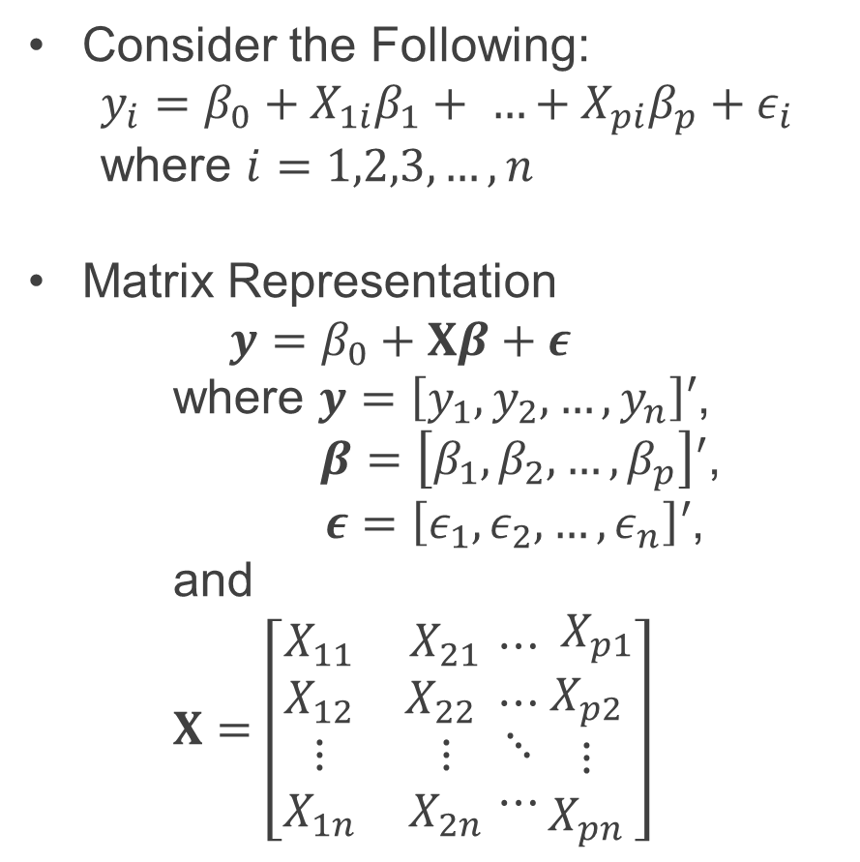
Linear Model
Consider the Following:
$$y_{i}=β_{0}+X_{1i}β_{1}+ …+X_{pi}β_{p}+ε_{i}$$
where $i=1,2,3,…,n$
Matrix Representation
$$y=β_{0}+Xβ+ε$$
where $y=\left[y_{1},y_{2},…,y_{n}\right]′$,
$β=\left[β_{1},β_{2},…,β_{p}\right]′$,
$ε=\left[ε_{1},ε_{2},…,ε_{n}\right]′$,
and
$$X=\left[\begin{matrix}X_{11} & X_{21} \\ \begin{aligned}X_{12} \\ ⋮ \\ X_{1n}\end{aligned} & \begin{aligned}X_{22} \\ ⋮ \\ X_{2n}\end{aligned} \end{matrix}\begin{matrix}⋯ \\ ⋯ \\ \begin{aligned}⋱ \\ ⋯\end{aligned}\end{matrix}\begin{matrix}\begin{aligned} X_{p1} \\ X_{p2}\end{aligned} \\ ⋮ \\ X_{pn}\end{matrix}\right]$$

Slide 5
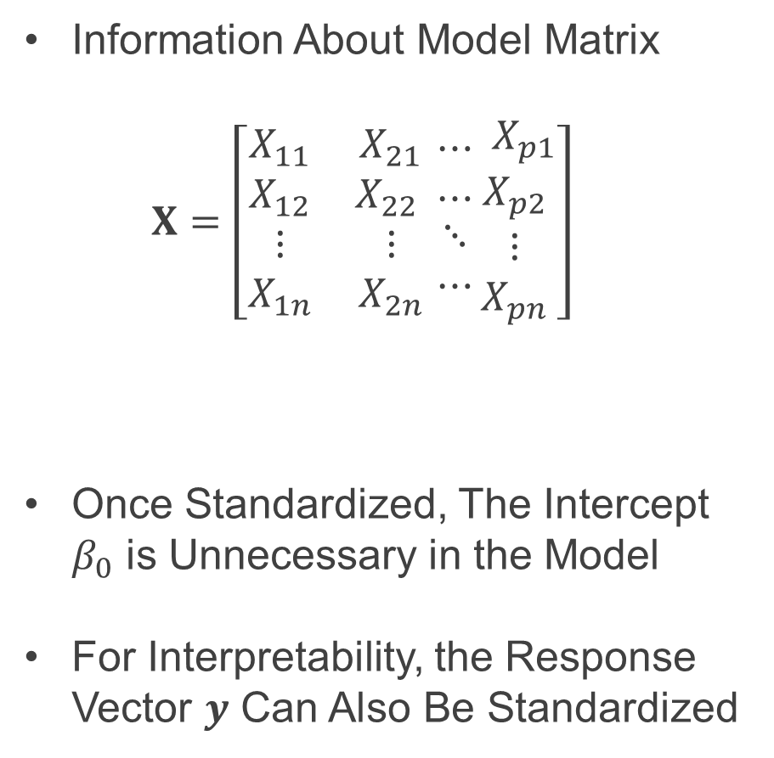
Linear Model
Information About Model Matrix
$$X=\left[\begin{matrix}X_{11} & X_{21} \\ \begin{aligned}X_{12} \\ ⋮ \\ X_{1n}\end{aligned} & \begin{aligned}X_{22} \\ ⋮ \\ X_{2n}\end{aligned} \end{matrix}\begin{matrix}⋯ \\ ⋯ \\ \begin{aligned}⋱ \\ ⋯\end{aligned}\end{matrix}\begin{matrix}\begin{aligned} X_{p1} \\ X_{p2}\end{aligned} \\ ⋮ \\ X_{pn}\end{matrix}\right]$$
Once Standardized, The Intercept $β_{0}$ is Unnecessary in the Model
For Interpretability, the Response Vector $y$ Can Also Be Standardized
This Matrix Should Be Standardized

Slide 6
Part 1: Simulate and Meditate
Run Chunk 1
Simulating Response From a Linear Model
All Predictor Variables in X are Standardized
What is n?
What is p?
What do We Know About the True Signal We Want to Detect?
> rnorm()
Sparse

Slide 7
Part 1: Simulate and Meditate
Run Chunk 2
Fitting Naïve Linear Model
Obtaining Confidence Intervals for Parameters
Figure Info
Show the Estimated Coefficients of Linear Model
Show Confidence Intervals for These Coefficients
What Does the Color Aesthetic Being Used For?
> confint(lm.model)

Slide 8
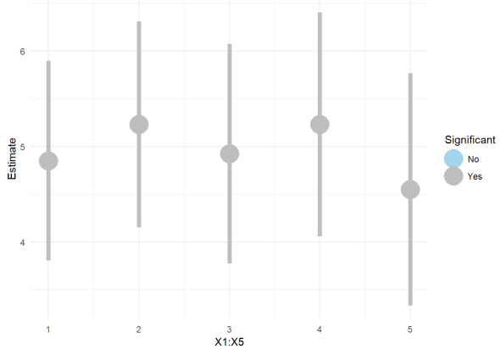
Part 1: Simulate and Meditate
Chunk 2 (Continued)
Knit the Document and Observe the 3 Graphics
Figure 1

Slide 9
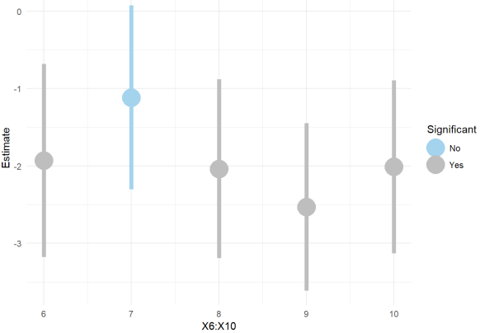
Part 1: Simulate and Meditate
Chunk 2 (Continued)
Figure 2
What is the Problem?

Slide 10
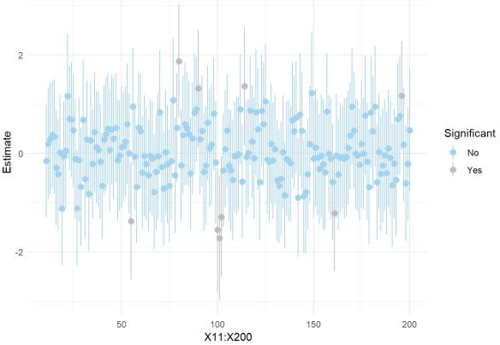
Part 1: Simulate and Meditate
Chunk 2 (Continued)
Figure 3
What is the Problem?

Slide 11

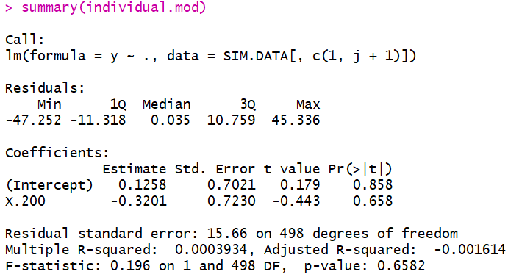
Part 1: Simulate and Meditate
Run Chunk 3
Regression for Each Predictor
Obtaining Coefficients
Obtaining P-Values
Save
Save

Slide 12
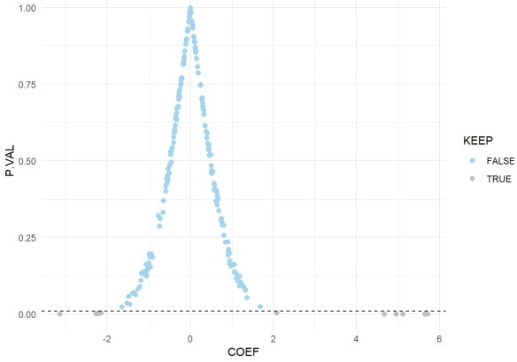
Part 1: Simulate and Meditate
Run Chunk 3
Figure Plots P-Values Against Coefficients

Slide 13
Part 1: Simulate and Meditate
Run Chunk 3
Suppose We Were to Keep Only the Predictor Variables that Had P-Values<0.01
Observe the Table
95% of Variables Ignored
5% of Variables Included
Errors (What is Worse?)
We Will Ignore Variables that Are Important
We Will Include Variables that Are Irrelevant
 | P-Val > 0.01 | P-Val < 0.01
Non-Zero | 1% | 4%
Zero | 94% | 1%

Slide 14
Part 1: Simulate and Meditate
Chunk 4
Try to Find the Smallest Cutoff Value So That We are Not Missing Important Variables
To Ensure We are Not Missing Important Variables, Should we Increase or Decrease the Original Cutoff (0.01)
What Cutoff Works?
Try Multiple Cutoffs and Observe the Table
Run the Code Inside the Chunk Until All 10 Important Variables are Retained for the Futre

Slide 15
Part 1: Simulate and Meditate
Chunk 4 (Continued)
Traditional Choice: 0.20
Output in Table
Fit Linear Model for Variables Kept in Consideration
 | P-Val > 0.01 | P-Val < 0.01
Non-Zero | 0% | 5%
Zero | 71% | 24%
None of the Non-Zero Parameters Will Be Ignored
> lm(y~.,data=SIM.DATA[,c(1,which(KEEP)+1)])

Slide 16
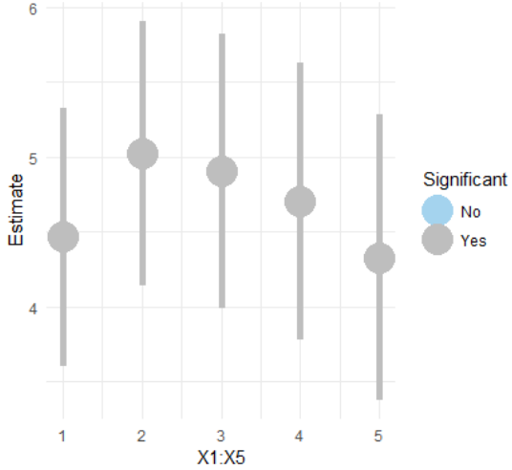
Part 2: Shrinkage Estimation
Chunk 4 (Continued)
Suppose Cutoff is 0.2
Figure 1

Slide 17
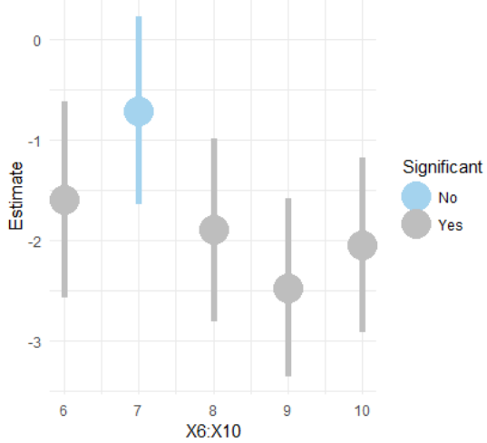
Part 1: Simulate and Meditate
Chunk 4 (Continued)
Figure 2

Slide 18
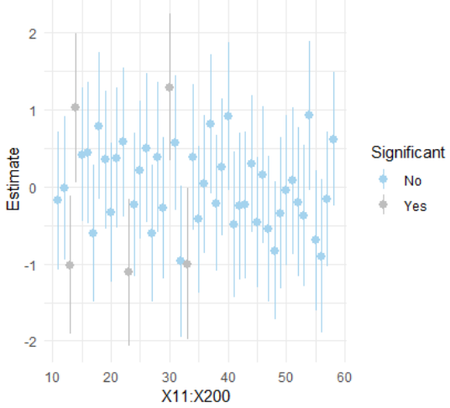
Part 1: Simulate and Meditate
Chunk 4 (Continued)
Figure 2

Slide 19
Part 1: Simulate and Meditate
Recap
Before Building Complex Models We are Performing a Simple Screening Procedure
Quick and Logical Approach
Problems
We May Lose Variables with Significant Interactions
We May Still Have Too Many
We May Retain Variables that are Highly Correlated
Other Approach: Fit Full Model and Retain Variables with Sufficiently Small P-Values (<0.2)

Slide 20
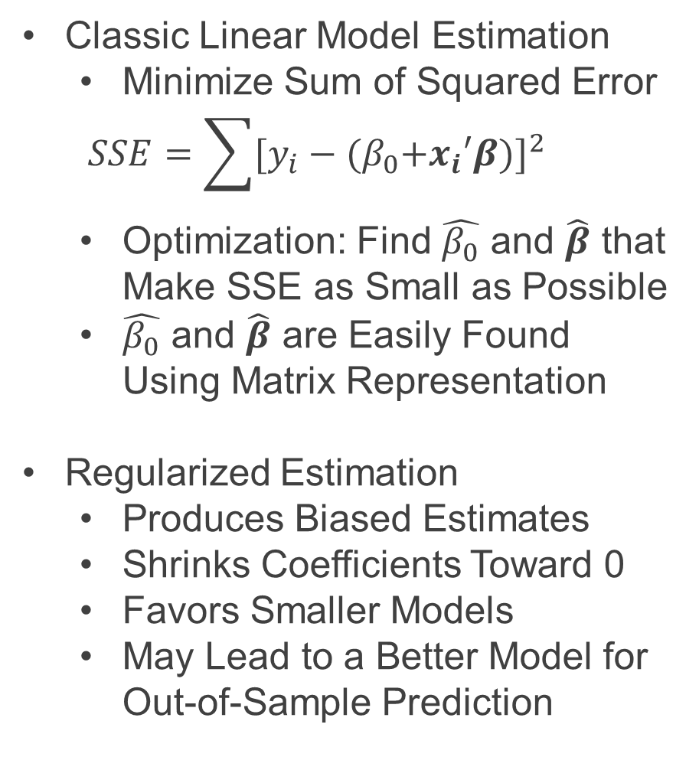
Part 2: Shrinkage Estimation and More Meditation
Classic Linear Model Estimation
Minimize Sum of Squared Error
$$SSE=\sum{[y_{i}−{{(β}_{0}+x_{i}′β)]}^{2}}$$
Optimization: Find $\hat{β_{0}}$ and $\hat{β}$ that Make SSE as Small as Possible
$\hat{β_{0}}$ and $\hat{β}$ are Easily Found Using Matrix Representation
Regularized Estimation
Produces Biased Estimates
Shrinks Coefficients Toward 0
Favors Smaller Models
May Lead to a Better Model for Out-of-Sample Prediction

Slide 21
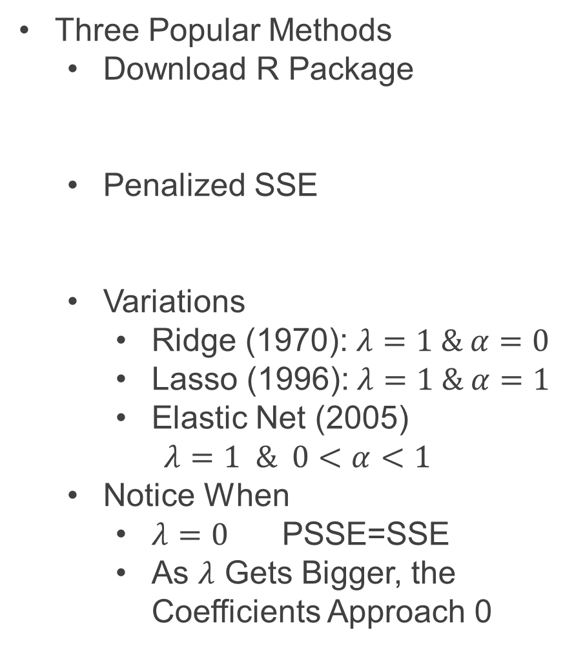
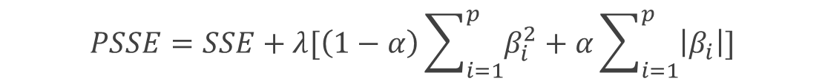
Part 2: Shrinkage Estimation and More Meditation
Three Popular Methods
Download R Package
Penalized SSE
Variations
Ridge (1970): $λ=1 \& α=0$
Lasso (1996):$λ=1 \& α=1$
Elastic Net (2005)
$$λ=1 \& 0<α<1$$
Notice When
$λ=0$ PSSE=SSE
As $λ$ Gets Bigger, the Coefficients Approach 0
> library(glmnet)
$$PSSE=SSE+λ[\left(1−α\right)\sum_{i=1}^{p}{β_{i}^{2}}+α\sum_{i=1}^{p}{\left|β_{i}\right|}]$$

Slide 22

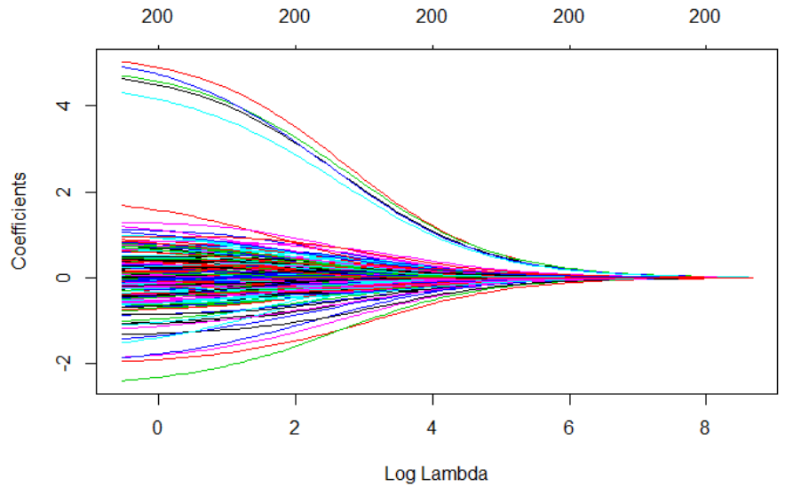
Part 2: Shrinkage Estimation and More Meditation
Run Chunk 1
Ridge Penalty

Slide 23

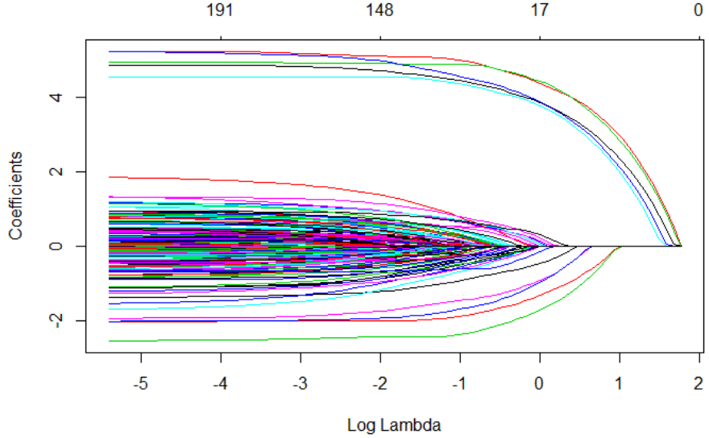
Part 2: Shrinkage Estimation and More Meditation
Chunk 1 (Continued)
Lasso Penalty

Slide 24


Part 2: Shrinkage Estimation and More Meditation
Chunk 1 (Continued)
Elastic Net Penalty

Slide 25
Irrelevant Nonsense
Watch Me Whip
Watch Me
Lasso

Slide 26
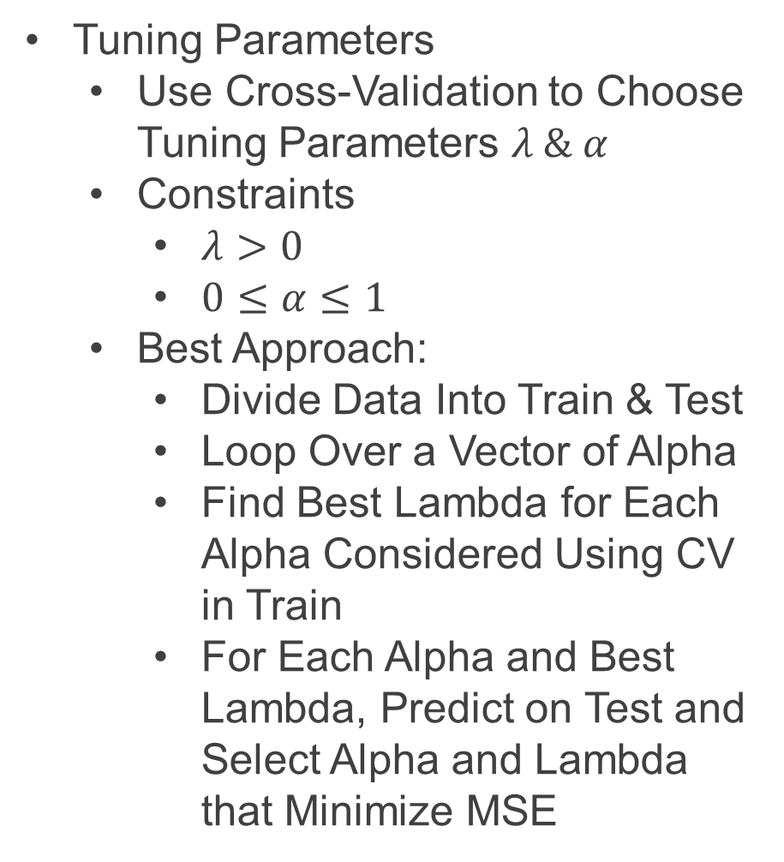
Part 2: Shrinkage Estimation and More Meditation
Tuning Parameters
Use Cross-Validation to Choose Tuning Parameters $λ \& α$
Constraints
$λ>0$
$0≤α≤1$
Best Approach:
Divide Data Into Train & Test
Loop Over a Vector of Alpha
Find Best Lambda for Each Alpha Considered Using CV in Train
For Each Alpha and Best Lambda, Predict on Test and Select Alpha and Lambda that Minimize MSE

Slide 27
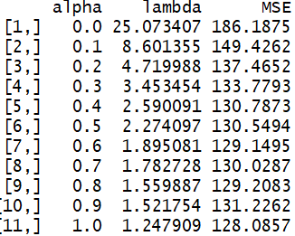

Part 2: Shrinkage Estimation and More Meditation
Chunk 2
Illustration of 10 Fold CV
Finding Best Combination of Alpha and Lambda
Best: $λ=1 \& α=1.24$

Slide 28
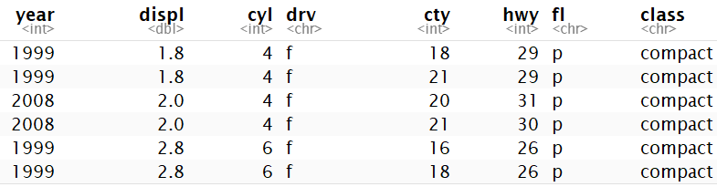
Part 3: Less Meditation and More Application
Built-In Data
n=234
Focus is on Modeling Hwy MPG
Subset Data to Include Only Wanted Covariates
There are p=7 Covariates
Difficulty
Fitting all Combinations
Considering All 2-Way Interaction Terms
> mpg

Slide 29
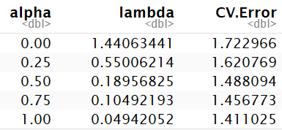
Part 3: Less Meditation and More Application
Run Chunk 1
Creating Model Matrix
Up to 2-Way Interactions
Now, p=115
Model Selection is Difficult
Dividing Data into Train & Test is Not Advised (n=234)
Run Chunk 2
Only a Few Options
Lowest Estimation of Prediction Error

Slide 30
Part 3: Less Meditation and More Application
Chunk 2 (Continued)
Understanding cv.glmnet Object
$lambda = Contains Vector of Lambda Auto-Generated
$cvm = Cross Validated Estimate of Error for Each Lambda in $lambda
$lambda.min = The Lambda that Leads to Smallest CV Measure of Error
$lambda.1se = The Largest Value of Lambda Such That Error is Within 1 SD of the Error Using $lambda.min

Slide 31
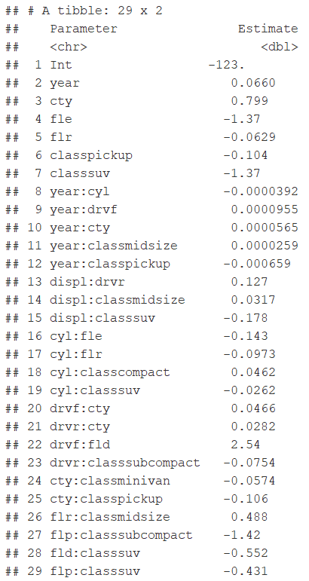
Part 3: Less Meditation and More Application
Run Chunk 3
Next
Use Best Alpha and Lambda
Observe the Non-Zero Coefficients
Plot Predictions and Errors
Table of Non-Zero
Coefficients
Before p=115
Now p=28

Slide 32
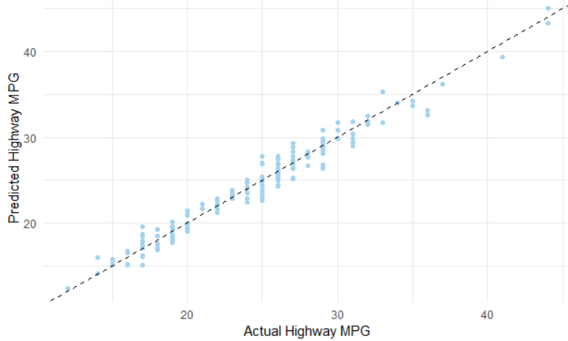
Part 3: Less Meditation and More Application
Chunk 3 (Continued)
Comparing Predict and Actual

Slide 33
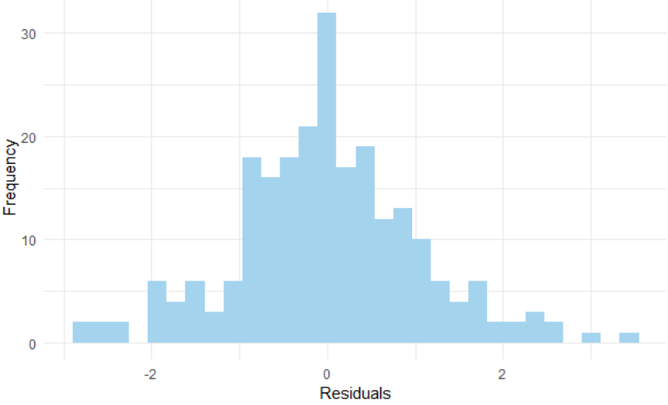
Part 3: Less Meditation and More Application
Chunk 3 (Continued)
Distribution of Residuals

Slide 34
Closing
Disperse and Make Reasonable Decisions

